Slide 1
Lecture 08
Iterations and Recursions

Slide 2
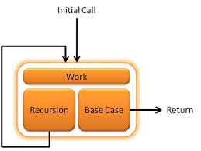
Recursive Method?
A recursive method is a method that calls itself.
There are two key requirements in order to make sure that the recursion is successful:
With each call the problem should become smaller and simpler.
The method will eventually should lead to a point where no longer calls itself – This point is called the base case.

Slide 3
Iteration
Repeated execution of a set of instructions is called iteration.
It is the act of repeating a process
to perform specific action on a collection of elements, one at a time,
each repetition of the process is called an iteration,
The results of one iteration are used as the starting point for the next iteration until the condition is met.
Iteration is most commonly expressed using loop statements.
For statement
While statement
Do While statement

Slide 4
Factorial
Factorial of a non-negative integer n is the product of all positive integers less than or equal to n.
5! = 5 * 4 * 3 * 2 * 1 ➔ 120
Factorial of n is denoted by n!
Factorial of 0 is 1.
Factorial for a negative number does not exist.

Slide 5
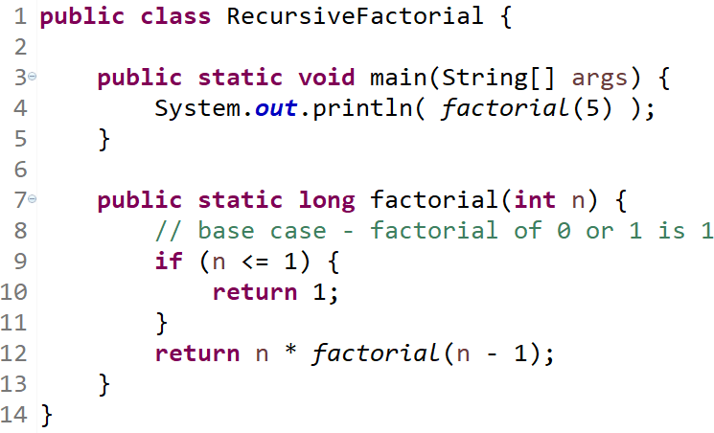
Factorial – Recursion

Slide 6
factorial(5)- Recursion Execution
This slide illustrates recursive steps computing 5!
Step 1: 5 * factorial(4)
Step 2: 4 * factorial(3)
Step 3: 3 * factorial(2)
Step 4: 2 * factorial(1)
Step 5: 1
Step 10: return 5 * 24 ➔ 120
Step 9: return 4 * 6 ➔ 24
Step 8: return 3 * 2 ➔ 6
Step 7: return 2 * 1 ➔ 2
Step 6: return 1

Slide 7
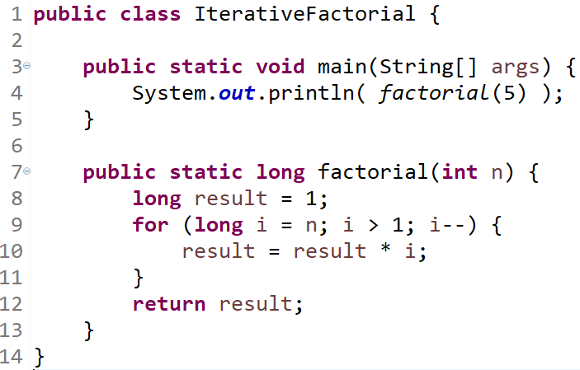
Factorial – Iteration

Slide 8
factorial(5)- Iteration Execution
This slide illustrates recursive steps computing 5!
Step 1: result = result * 5 ➔ result = 1 * 5
Step 2: result = result * 4 ➔ result = 5 * 4
Step 3: result = result * 3 ➔ result = 20 * 3
Step 4: result = result * 2 ➔ result = 60 * 2
 Step 5:
return result ➔ return 120

Slide 9
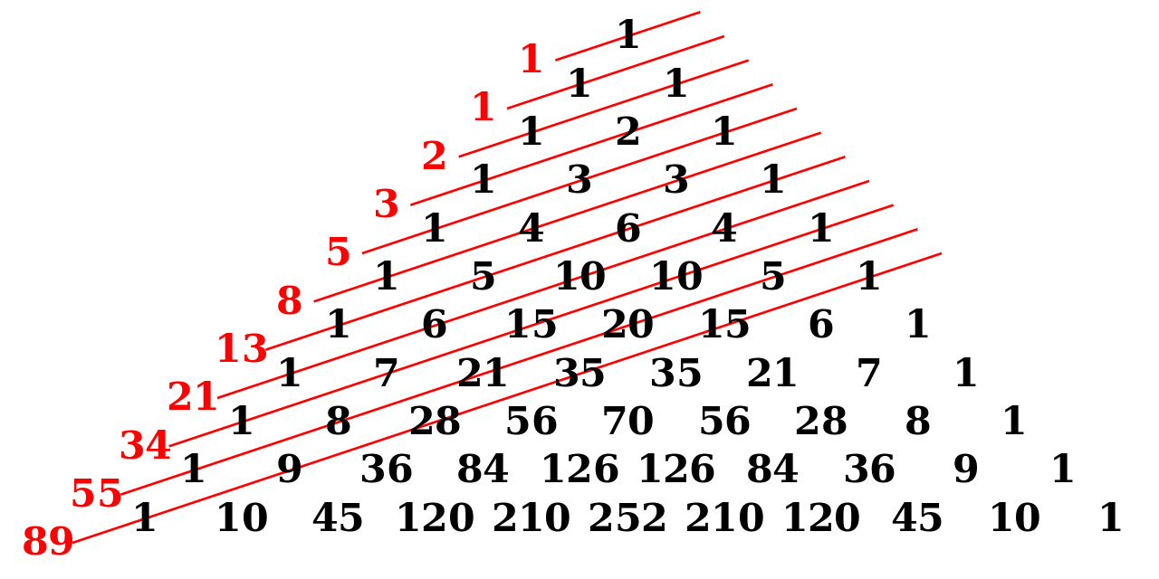
Fibonacci Number
The Fibonacci sequence is a series of numbers where a number is found by adding up the two numbers preceding it.
The Fibonacci sequence beings with 0 and 1.
The Fibonacci sequence is written as a rule as follow:
 Fibonacci_{n} = Fibonacci_{n-1} + Fibonacci_{n-2}
The first 11 Fibonacci numbers Fibonacci_{n} for n = 0, 1, 2, … , 11 are:
F₀ | F₁ | F₂ | F₃ | F₄ | F₅ | F₆ | F₇ | F₈ | F₉ | ^{F}10
0 | 1 | 1 | 2 | 3 | 5 | 8 | 13 | 21 | 34 | 55

Slide 10
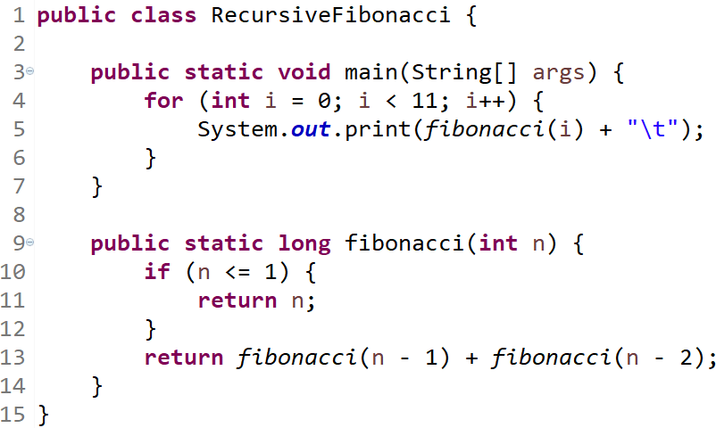
Fibonacci – Recursion

Slide 11
fibonacci(5)- Recursion Execution
5
fibonacci(5)
3
2
fibonacci(4)
fibonacci(3)
2
1
1
1
fibonacci(3)
fibonacci(2)
fibonacci(2)
fibonacci(1)
1
1
1
0
1
0
fibonacci(2)
fibonacci(1)
fibonacci(1)
fibonacci(0)
fibonacci(1)
fibonacci(0)
1
0
fibonacci(1)
fibonacci(0)

Slide 12
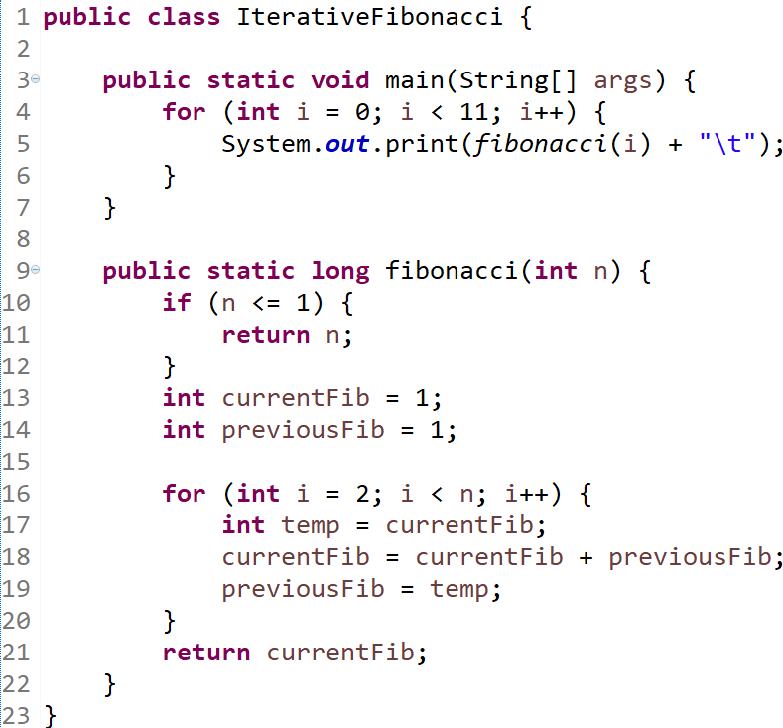
Fibonacci – Iteration

Slide 13
GCD (Greatest Common Divisor)
To calculate and find the Greatest Common Divisor (GCD) of two integer numbers num1 and num2 using Euclid’s algorithm is another great and suited example demonstrating recursion.
Euclidean algorithm is defined as follow:
if num2 == 0 then GCD (num1, num2) is num1
else GCD (num1, num2) is GCD (num2, modulus(num1, num2))
Note: The modulus is the remainder when num1 is divided by
num2 and it is computed in Java by using the % operator.
Notes:
prime factorizations + Venn diagrams
48 = 2 × 2 × 2 × 2 × 3
180 = 2 × 2 × 3 × 3 × 5
gcd(a,0)= a
gcd(a,b)= gcd(b, a % b)
gcd(48,18) = gcd(18, 48%18) = gcd(18, 12) = gcd(12, 18%12) = gcd(12, 6) = gcd(6, 12%6) = gcd(6, 0) = 6

Slide 14
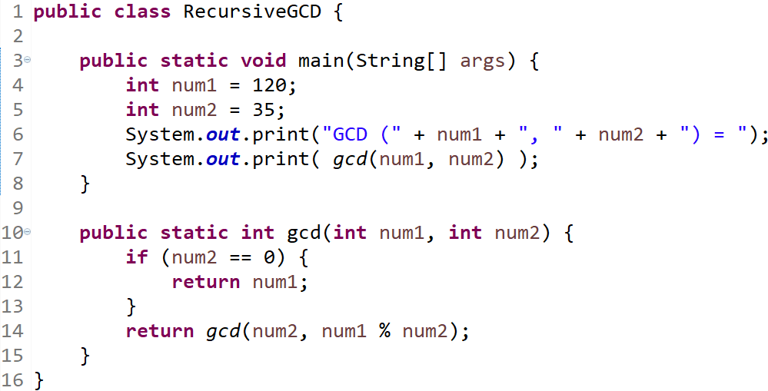
GCD – Recursion

Slide 15
gcd(120, 35)-Recursion Execution
Following steps illustrate calculating gcd(187, 77):
 Step 1: gcd(120, 35)
 Step 2: gcd(35, 15)
 Step 3: gcd(15, 5)
 Step 4: gcd(5, 0)
Step 10: return 5
Step 9: return 5
Step 8: return 5
Step 7: return 5
 Step 5: 5
Step 6: return 5

Slide 16
Exercise
Solve the following using prime factorization and Euclidian GCD method.
60, 36
270, 192
516, 1220

Slide 17
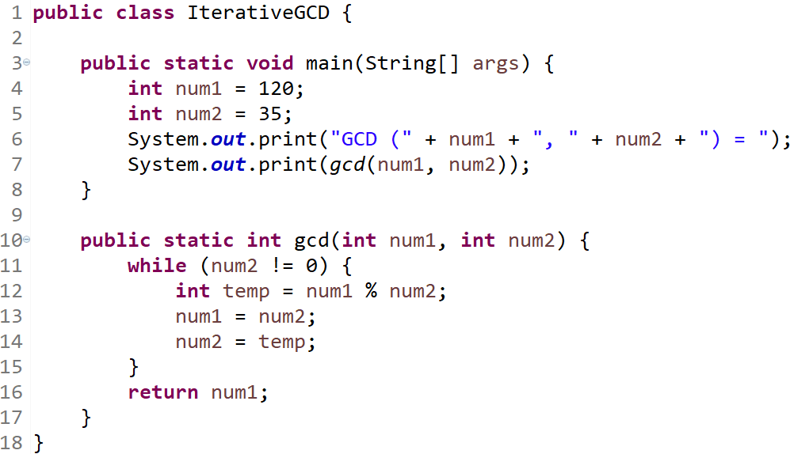
GCD – Iteration

Slide 18
Binary Search
Binary search – also called half-interval search, logarithmic search or binary chop – is a search algorithm that finds the position of a target value within a sorted array.
Binary search is a fast and efficient search algorithm with run-time complexity of Ο(log n).
Binary search works on the principle of divide and conquer.
Binary search compares the target value to the middle element of the array:
If they are equal, then the index of item is returned.
If they are unequal, the half in which the target cannot lie is eliminated and the search continues on the remaining half until it is successful.
If the search ends with the remaining half being empty, the target is not in the array.

Slide 19
binarySearch(input,0, 7, 25)- Recursion Execution
binarySearch(input, 0, 7, 25)
middle = (0 + 7) / 2 ➔ 3, check sortedArray[3]
1 | 5 | 10 | ²⁰middle | ²⁵target | 30 | 44 | 55
They are not match; target value ‘25’ is > middle value ‘20’. Hence …
binarySearch(input, 4, 7, 25) middle = (4 + 7) / 2 ➔ 5, check sortedArray[5]
1 | 5 | 10 | 20 | ²⁵target | ³⁰middle | 44 | 55
They are not match; target value ‘25’ is < middle value ‘30’. Hence …
binarySearch(input, 4, 4, 25) middle = (4 + 4) / 2 ➔ 4, check sortedArray[4]
1 | 5 | 10 | 20 | ²⁵target middle | 30 | 44 | 55
They are matched; target value ‘25’ is == middle value ‘25’. Hence …
return middle; ➔ return 4;

Slide 20
Conclusion
There are similarities between recursion and iteration.
Actually, any problems that can be solved with iterations can be done with recursions.
 There are some programming languages that use recursion exclusively.
In the factorial, greatest common divisor and binary search problems, the iterative and recursive solutions use roughly the same algorithms, and their efficiency is approximately the same.
In the exponentiation problem e.g. Fibonacci;
the iterative solution takes linear time to complete,
while the recursive solution executes in log time.

Slide 21
Conclusion
There are some problems that are simple to solve with recursions, but they are comparatively difficult to solve with iterations (e.g. tree traversal).
Iterations are recommended for algorithms that are easier to explain
in terms of iterations.
Recursions are good a problem can be solved by divide and conquer
technique (e.g. Searching binary trees).
 Warning: Infinite recursion causes a Stack Overflow Error!

